Slide 1

HoneyPot Based IDS
By : Anurag Ranjan,
Abhishek Singh

Slide 2
HoneyPot
A honeypot is a network-attached system set up as a decoy to lure cyber attackers and detect, deflect and study hacking attempts to gain unauthorized access to information systems.
The function of a honeypot is to represent itself on the internet as a potential target for attackers -- usually, a server or other high-value asset -- and to gather information and notify defenders of any attempts to access the honeypot by unauthorized users.

Slide 3

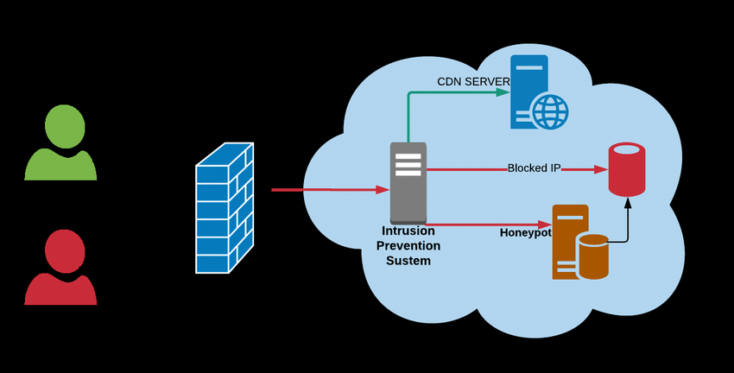

Slide 4
Intrusion Detection HoneyPot(IDH)
An Intrusion Detection HoneyPot(IDH) is a security resourse placed inside your network perimeter that generates alerts when probed, attacked or compromised.

Slide 5
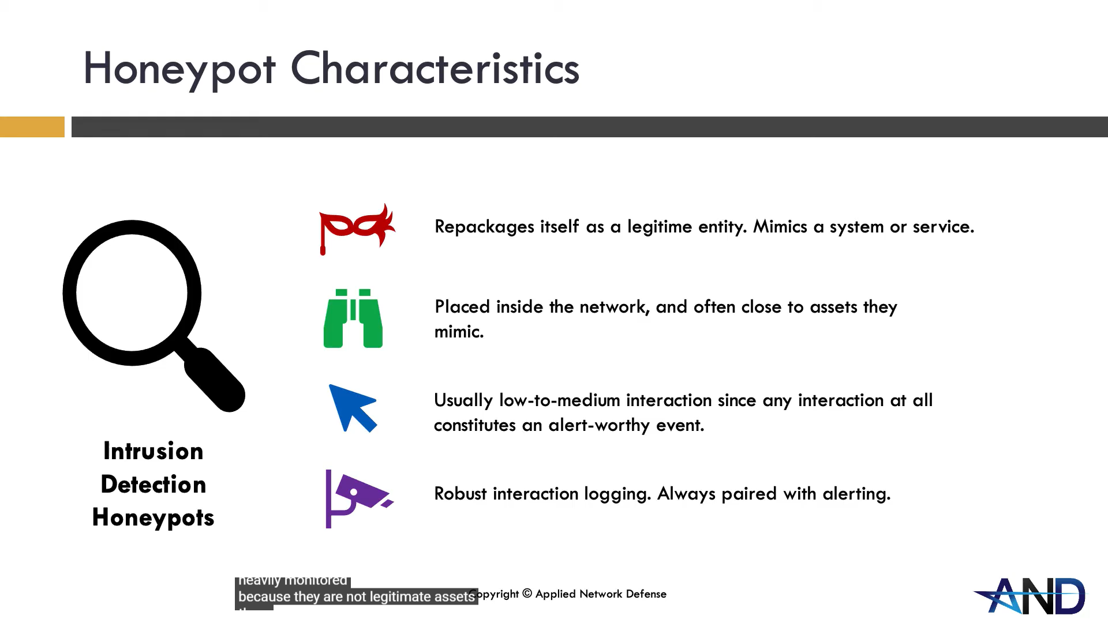

Slide 6
Objectives
Improve security within an organizations network.
Document this project clearly.
Provide insight on potential risks.
Spoof packets such as SSH or SMB on specific ports.
Python will be used to program these features.
Host this project on a virtual machine.
Use a packet capture tool on the same virtual machine.

Slide 7
Functional Requirements
Here the functional requirements for this project will be listed. These are functions which the Honeypot System itself will have.
1. Ability to adapt to different ports as they are being scanned.
2. The ability to spoof packets and send them to different ports.
3. To log activity on these specific ports.
4. To use packet capture tools on this system.
5. Use Linux on a virtual machine to host this system.
6. A script which can interact with the Honeypot.

Slide 8
Tools Used
1. VMWare: Was used in order to host the CentOS and Kali virtual machines.
2. ParrotOS: Was chosen to act as the OS to host the Honeypot on.
3. Python: Used to write scripts for the Honeypot.
4. Scapy: This was used when crafting packets the spoof SSH or SMB.
5. T-Shark: Chosen to record activity on ports 22 or 445.
6.Nmap: Used to scan ports by the attacker.
7. Slack: This messaging app was used when creating a chatbot to alert on the Honeypots attackers.
8. Apache: This was used to Host a website on the Honeypot to lure in attackers.
9. Kali: This was used for testing purposes.

Slide 9
Implementation Approach

Slide 10
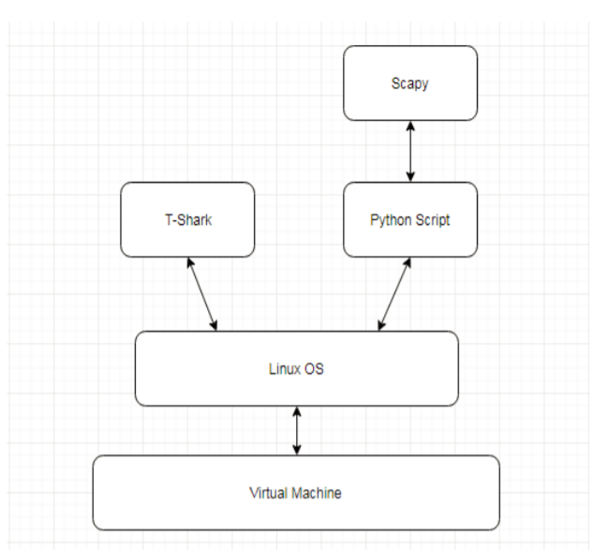
Architecture

Slide 11
Starting from the top, Scapy is a package which can be imported into Python, which appears too be the most important aspect of the Honeypot.
The next layer in the architecture diagram includes a Python script.
Alongside python an instance of T-Shark will be running.
T-Shark is a packet capture tool which runs on the command line.
Underneath each of these tools, a Linux Operating System will lie. This OS will be server based.
In order too host the Linux Operating system, a virtual machine will be used. The choice for virtual machine software for this Honeypot is VirtualBox.

Slide 12
Use Case Description
The following section will enumerate each of the functional requirements for this project and describe how each of these requirements will be tackled.

Slide 13
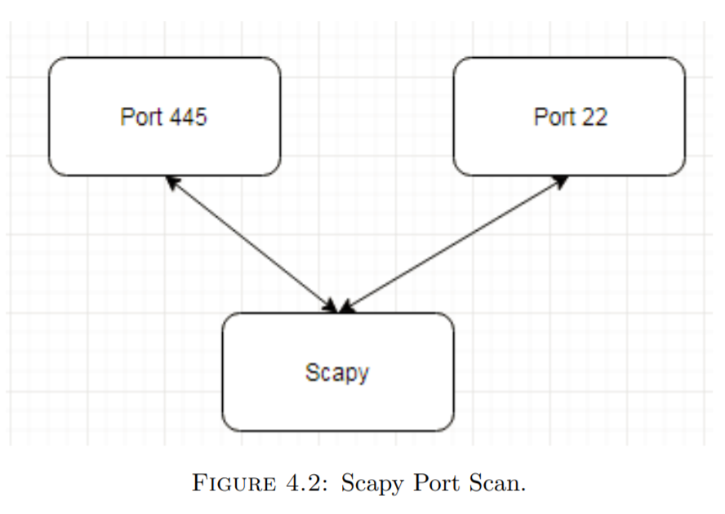
Ability to adapt to different ports as they are being scanned.

Slide 14
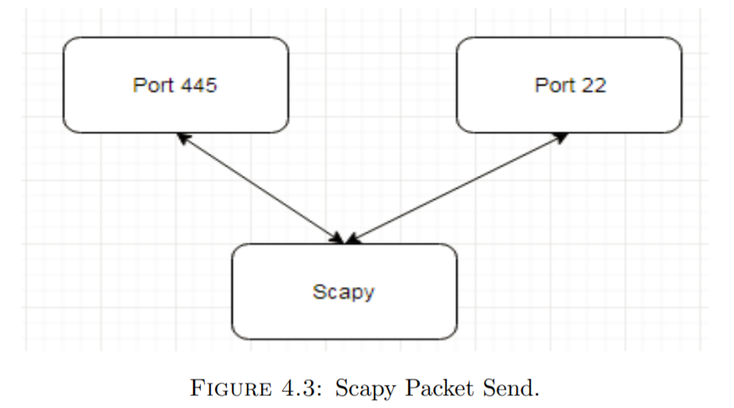
The ability to spoof packets and send them to different ports

Slide 15
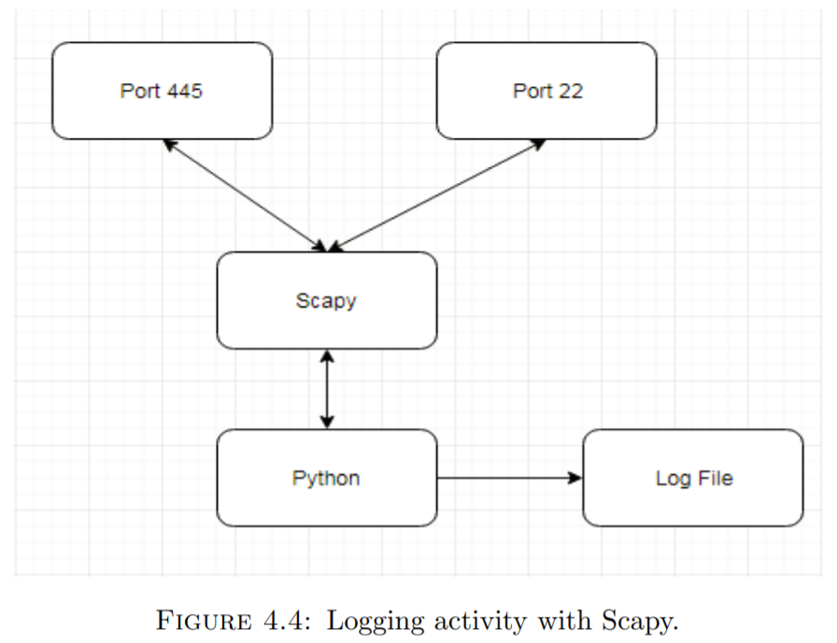
To log activity on these specific ports

Slide 16
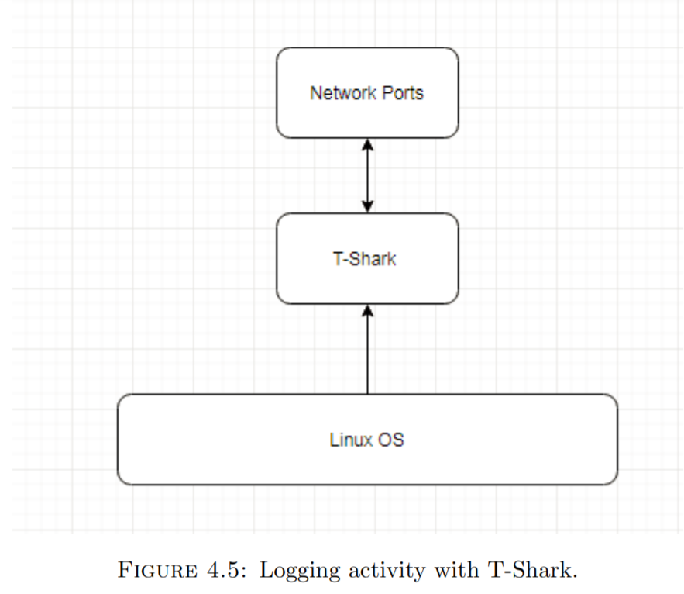
To use packet capture tools on this system.

Slide 17
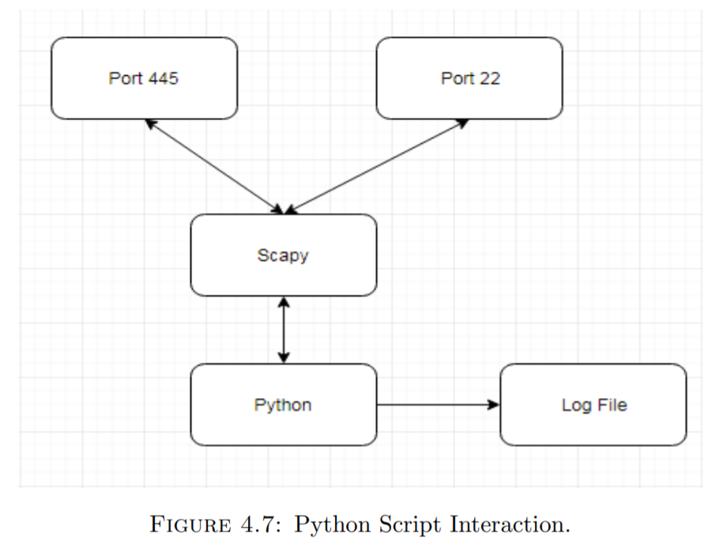
Use Linux on a virtual machine to host this system

Slide 18
Scapy Commands
send(IP(dst="127.0.0.1")/ICMP()/"HelloWorld")
send - this tells Scapy that you want to send a packet (just a single packet).
IP - the protocol of the packet you want to create.
(dst=”127.0.0.1”) - the destination IP to send the packet to.
/ICMP() - Create an ICMP packet with the default values provided by Scapy.
/”HelloWorld” - the payload to include in the ICMP packet.

Slide 19
Wireshark Capture
Scapy command: send(IP(dst="127.0.0.1")/ICMP()/"HelloWorld")
Wireshark capture:
Internet Protocol Version 4, Src: 127.0.0.12 (127.0.0.12), Dst: 127.0.0.1 (127.0.0.1)
Protocol: ICMP
Data: 48656c6c6f576f726c64 or “HelloWorld”

Slide 20
Sending a ping packet
ip=IP() # Creates an IP header ip.src=’192.168.1.25′ # Source address in the IP header with local IP ip.dst =’ 192.168.1.100′ # Destination address in the IP header. icmp=ICMP() # Creates an ICMP header icmp.type=8 # Type value inserted in ICMP header as 8 for ping icmp.code=0 # Code value inserted in ICMP header as 0 for ping send(ip/icmp) # Sending ping packet.

Slide 21
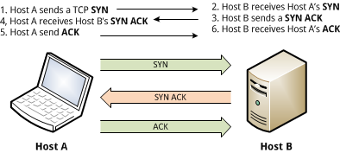
TCP Connection Establishment

Slide 22
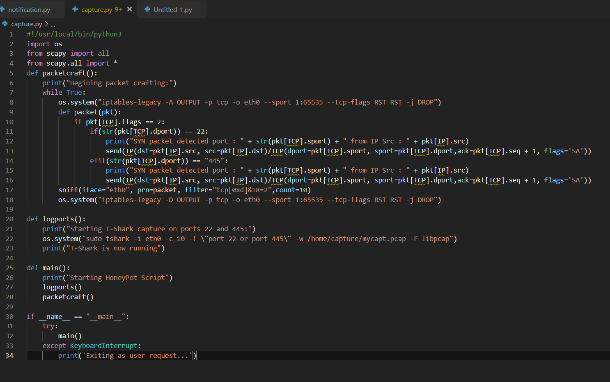
Capture.py

Slide 23

notification.py

Slide 24
Working

Slide 25
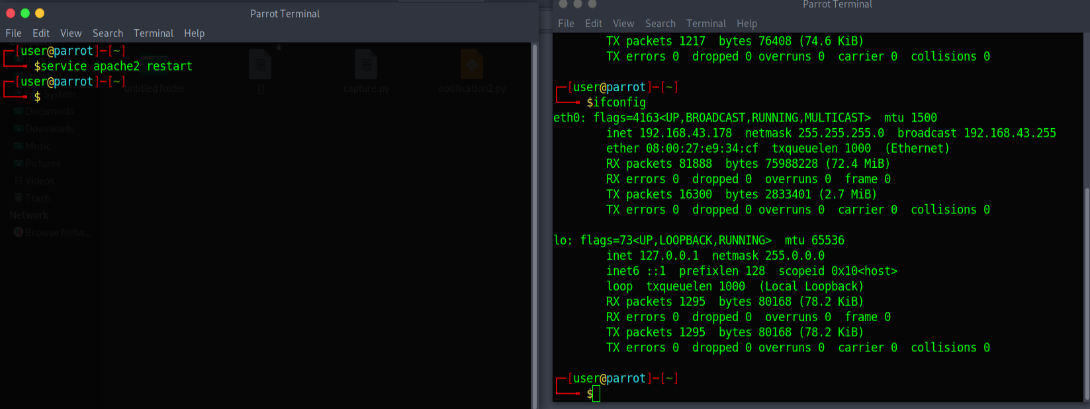
Step 1: Host the mimic server on virtual host.
$service apache2 restart : Used to start the apache server on the virtual host.
$ifconfig : Used to check the ip of the virtual host.
The mimic website is hosted on ip: 192.168.43.178

Slide 26

The Website is now hosted succesfully

Slide 27
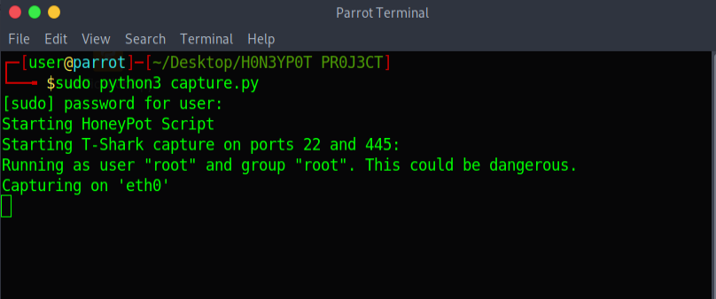
Step 2: Runnig the Capture script to:
: Ability to adapt to different ports as they are being scanned.
: The ability to spoof packets and send them to different ports.
: To log activity on these specific ports.
: To use packet capture tools on this system.
$sudo python3 capture.py

Slide 28
Explaination
1. Making the script capable of logging any activities on ports 22 and 445.
• The script should now log activity only ports 445 and 22.
os.system("tshark -i eth0 -c 10 -f \"port 22 or port 445\" -w /home/capture/mycapt.pcap -F libpcap")
2.Manipulating the script to only show every port as open to the intruder.
• When this python script is ran, it should show each port as open
os.system("iptables-legacy -A OUTPUT -p tcp -o eth0 --sport 1:65535 --tcp-flags RST RST -j DROP")
def packet(pkt):
if pkt[TCP].flags == 2:
if(str(pkt[TCP].dport)) == 22:
print("SYN packet detected port : " + str(pkt[TCP].sport) + " from IP Src : " + pkt[IP].src)
send(IP(dst=pkt[IP].src, src=pkt[IP].dst)/TCP(dport=pkt[TCP].sport, sport=pkt[TCP].dport,ack=pkt[TCP].seq + 1, flags='SA'))
elif(str(pkt[TCP].dport)) == "445":
print("SYN packet detected port : " + str(pkt[TCP].sport) + " from IP Src : " + pkt[IP].src)
send(IP(dst=pkt[IP].src, src=pkt[IP].dst)/TCP(dport=pkt[TCP].sport, sport=pkt[TCP].dport,ack=pkt[TCP].seq + 1, flags='SA'))
sniff(iface="eth0", prn=packet, filter="tcp[0xd]&18=2",count=10)
os.system("iptables-legacy -D OUTPUT -p tcp -o eth0 --sport 1:65535 --tcp-flags RST RST -j DROP")
def logports():

Slide 29
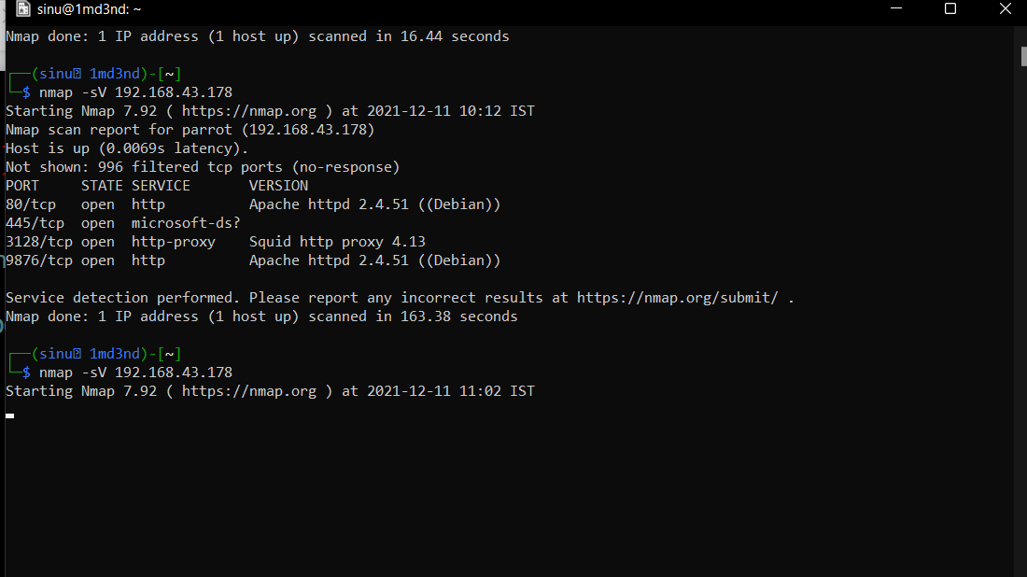
Intruder POV
1.Inspect a website.
2. Information gathering about the website.
3. Try to scan for ports using nmap in its own environment.
─$ nmap -sV 192.168.43.178

Slide 30
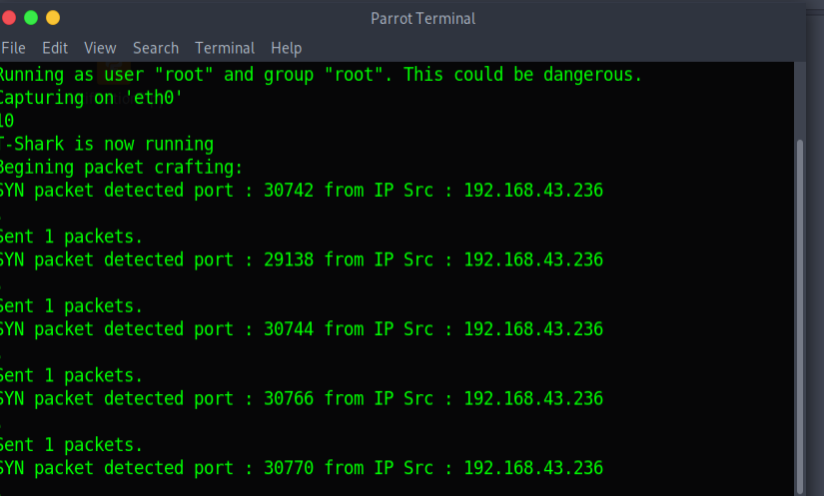
As the intruder starts the scan for ports using , meanwhile our script (capture.py) will capture the TCP SYN packets using wireshark and the script will send back SYN ACK packet using scapy to the intruder showing that the port is open.
And we will easily extract the ip of Intruder using captured packets.
here it is SYN packet detected port : 30772 from IP Src : 192.168.43.236
ip of Intruder is : 192.168.43.236

Slide 31
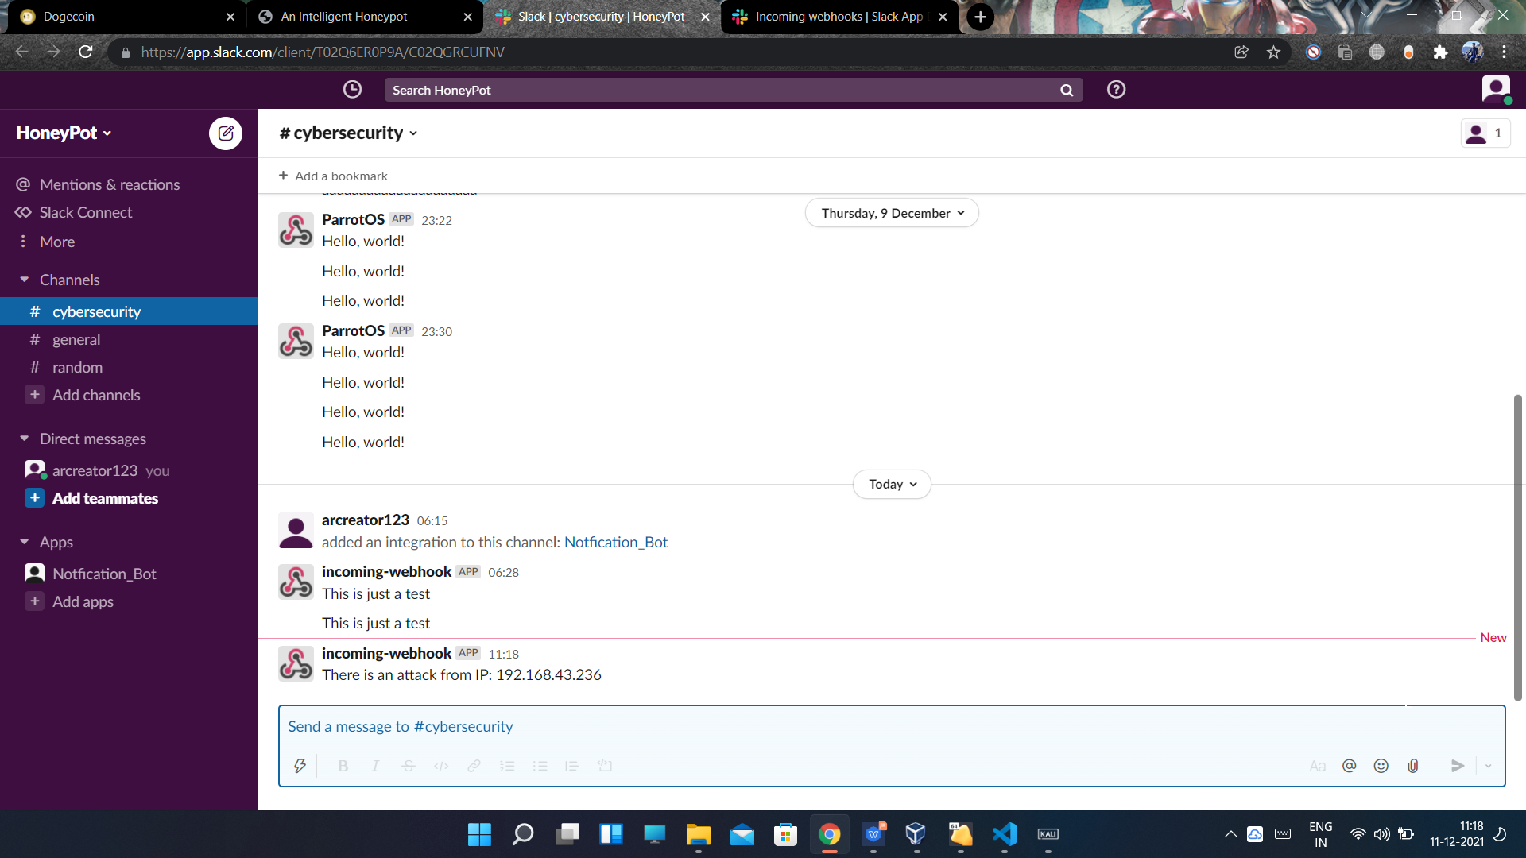

Slack Notification
Here we will be informed by notification.py script that there is an attack
on our server and it will show the IP of the Intruder.

Slide 32
Thank You

